Slide 1
Estimation of a nonlinear system with Extended Kalman Filter and C4dynamics

Slide 2

The nonlinear system
estimation of the ballistic coefficient ($β$) of a target is necessary for accurate track of ballistic targets
ballistic coefficient ($β$): The ability of a body to overcome air resistance in flight
high $β$ = small drag
$β=\frac{m}{c_{d}⋅s} \left(\frac{kg}{m^{2}} or\frac{lb}{ft^{2}}\right)$
$m$ mass
$c_{d}$ aerodynamic coefficient of drag
$s$ reference surface area
The equation of motion in one dimension (height) is given by:
${\dot{v}}_{z}=\frac{f_{drag}}{m}−g=\frac{0.0034⋅e^{−\frac{z}{22000}}⋅g⋅v_{z}^{2}}{2⋅β}−g$
Notes:
Post 1: why ekf? The difference between linear and nonlinear.
What’s the punch?
None of the following systems could be developed: ..
Missile guidance, satellite navigation, autonomous driving, and much more could not have been developed without the support of extended Kalman filter estimation.
While the Kalman filter excels in linear systems, the EKF boldly extends its prowess to tackle the complexities of nonlinear systems, making it a dynamic force in modern estimation algorithms

Slide 3


EKF - the process
Predict equations
$x=x+f\left(x\right)⋅dt$
$P=F⋅P⋅F^{T}+Q_{k}$
$f\left(x\right)={\left[\begin{matrix}v_{z} & \frac{0.0034⋅e^{−\frac{z}{22000}}⋅g⋅v_{z}^{2}}{2⋅β}−g & 0\end{matrix}\right]}^{T}$
$F=I+\frac{∂f}{∂x}{\left.​\right|}_{x=\hat{x}}⋅dt$
$Q=zeros\left(3,3\right), Q\left[3,3\right]=φ_{s}$
$Q_{k}=\int_{0}^{dt}{F(τ)⋅Q⋅{F(τ)}^{T}⋅dτ}$
State
$X=\left[\begin{matrix}z & v_{z} & β\end{matrix}\right]$
$z$ Height position
$v_{z}$ Height velocity
$β$ Ballistic coefficient
Dynamics
$\dot{z}=v_{z}$
${\dot{v}}_{z}=\frac{0.0034⋅e^{−\frac{z}{22000}}⋅g⋅v_{z}^{2}}{2⋅β}−g$
$\dot{β}=u_{s}$
$x_{0}={\left[\begin{matrix}z_{0} & v_{z_{0}} & β_{0}\end{matrix}\right]}^{T}$
$diag(P_{0})=[\begin{matrix}σ_{k}^{2} & {v_{z}}_{err}^{2} & β_{err}^{2}\end{matrix}]$
Noise
$β$ uncertainty $σ_{β}^{2}=φ_{s}$
Notes:
The nonlinear part of the filter is manifested in the dynamic equations. These include the height velocity derivative which when expressed in terms of the ballistic coefficient $β$ is a nonlinear function of the height position $z$, the height velocity $v_{z}$, and the ballistic coefficient $β$ itself.
When the process noise matrix $Q$ is time-varying, you can provide the predict function with it at each call.

Slide 4


EKF - the measure
Sensor
Height position radar
$Z=z$
Noise
Measurement variance $σ_{z}^{2}$
Rate
50msec
Update equations
$k={P⋅H^{T}⋅\left(H⋅P⋅H^{T}+R_{k}\right)}^{−1}$
$x=x+k⋅(Z−H⋅x)$
$P=\left(I−k⋅H\right)⋅P$
$H=[\begin{matrix}1 & 0 & 0\end{matrix}]$
$R_{k}=σ_{k}^{2}$
Notes:
The nonlinearity may be manifested in different ways.
The system equations and the measure equations must be linearized even for the case of the extended Kalman filter, for the calculations of P and k. but as opposed to the regular Kalman filter, they are not linearized once about an equilibrium state, but rather they are linearized at each step about the estimated state.
In fact not always both the process equations and the measure equations are both nonlinear, and there may be mixed situations, i.e. either the process equations nonlinear or the measure equations nonlinear. But if both the process equations are linear and the measure equations are linear, then the selection in extended klaman filter is basically a missunderstandning, and the effort to calculate the linearized matrices at each step is total useless.
transition matrix F and the measure must be linearized for the calculation of P at the predict stage.
If the system equations are nonlinear, then the transition matrix F is linearized about the current estimated step at each step.
But

Slide 5

Predict & Update
Predict equations
$x=x+f\left(x\right)⋅dt$
$P=F⋅P⋅F^{T}+Q_{k}$
$f\left(x\right)={\left[\begin{matrix}v_{z} & \frac{0.0034⋅e^{−\frac{z}{22000}}⋅g⋅v_{z}^{2}}{2⋅β}−g & 0\end{matrix}\right]}^{T}$
$F=I+\frac{∂f}{∂x}{\left.​\right|}_{x=\hat{x}}⋅dt$
$Q=zeros\left(3,3\right), Q\left[3,3\right]=φ_{s}$
$Q_{k}=\int_{0}^{dt}{F(τ)⋅Q⋅{F(τ)}^{T}⋅dτ}$

Slide 6

Predict & Update
Update equations
$k={P⋅H^{T}⋅\left(H⋅P⋅H^{T}+R_{k}\right)}^{−1}$
$x=x+k⋅(Z−H⋅x)$
$P=\left(I−k⋅H\right)⋅P$
$H=[\begin{matrix}1 & 0 & 0\end{matrix}]$
$R_{k}=σ_{k}^{2}$

Slide 7

C4dynamics
The Python Framework for Motion Estimation and Control
Datapoint
Rigidbody
Sensors
Detectors
Filters

Slide 8
Target simulation
''' true target '''
tgt = c4d.datapoint(z = z0, vz = vz0)
tgt.beta = beta0 # balistic coefficient # main loop
for t in np.arange(0, tf, dt):
''' true target motion '''
fz = tgt.mass * (0.0034 * np.exp(-tgt.z / 22000) * c4d.g_fts2 * tgt.vz**2 / 2 / tgt.beta - c4d.g_fts2)
tgt.inteqm([0, 0, fz], dt)
tgt.store(t)

Slide 9
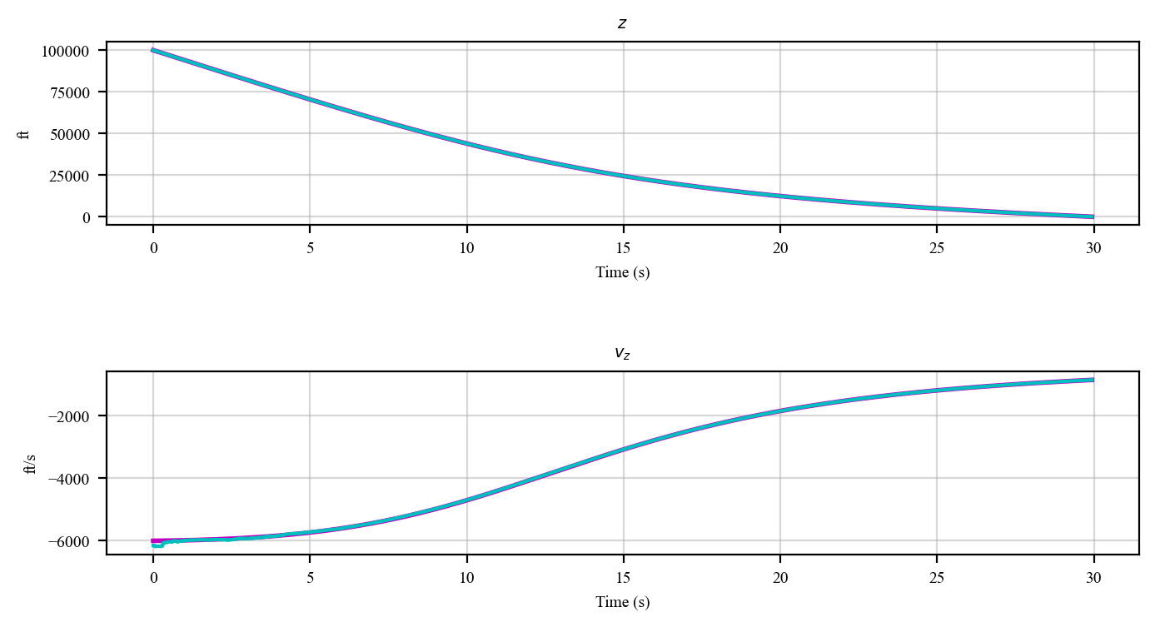
Target simulation

Slide 10
Radar simulation
radar_noise = c4d.sqrt(500) # 1 sigma
''' altitude radar '''
rdr = c4d.sensors.seeker(dt = 50e-3, rng_noise_std = radar_noise)
# main loop
for t in np.arange(0, tf, dt):
''' measure '''
rdrout = rdr.measure(tgt, t = t)

Slide 11
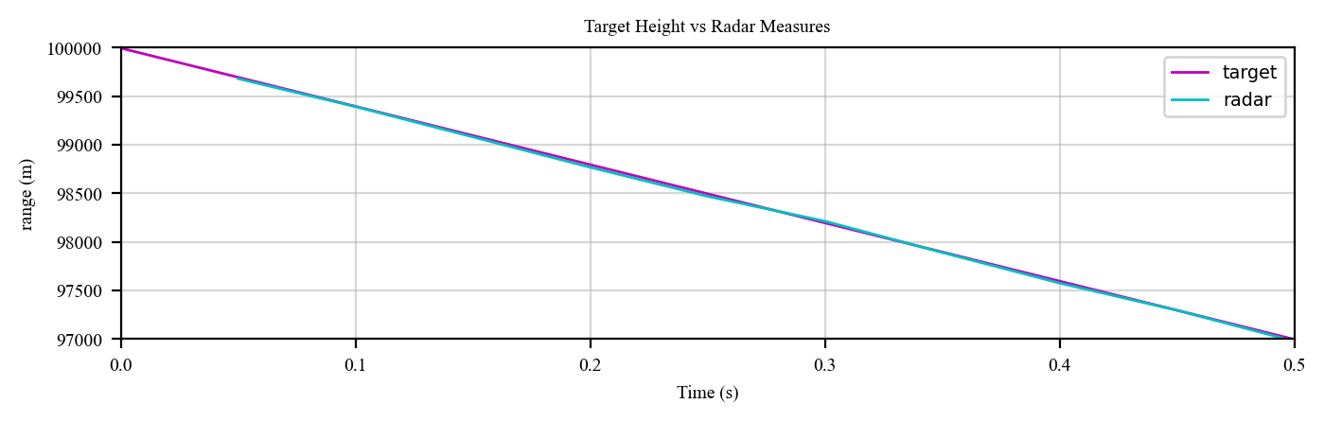
Radar simulation

Slide 12

Kalman Predict
Equations
$x=x+f\left(x\right)⋅dt$
$P=F⋅P⋅F^{T}+Q_{k}$
$f\left(x\right)={\left[\begin{matrix}v_{z} & \frac{0.0034⋅e^{−\frac{z}{22000}}⋅g⋅v_{z}^{2}}{2⋅β}−g & 0\end{matrix}\right]}^{T}$
$F=I+\frac{∂f}{∂x}{\left.​\right|}_{x=\hat{x}}⋅dt$
$Q=zeros\left(3,3\right), Q\left[3,3\right]=φ_{s}$
$Q_{k}=\int_{0}^{dt}{F(τ)⋅Q⋅{F(τ)}^{T}⋅dτ}$

Slide 13
Kalman Predict
# nonlinear derivatives for x
fx = [tgt_trk.vz, rgvzb * tgt_trk.vz / 2 - c4d.g_fts2, 0]
x = [tgt_trk.z, tgt_trk.vz, tgt_trk.beta]
xout = tgt_trk.kalman.predict(x, fx = fx, F = Phi, Q = Q)

Slide 14
Implementation
Both the true target (for reference) and the estimated target are simulated with c4dynamics’ datapoint
''' true target '''
tgt = c4d.datapoint(z = z0, vz = vz0)
tgt.beta = beta0 # balistic coefficient
''' measured target '''
tgt_trk = c4d.datapoint(z = tgt.z0 + 25, vz = tgt.vz -150)
tgt_trk.beta = tgt.beta + betaerr0
''' kalman '''
tgt_trk.kalman = c4d.filters.e_kalman(p0, dt = dt, H = H, Q = Q, R = R)
''' altitude radar '''
rdr = c4d.sensors.seeker(isideal = True, dt = 50e-3, rng_noise_std = radar_noise)

Slide 15
Implementation
With c4d The system matrices (Q, R) may be introduced once at initialization (for constant matrices) or at each call for predict() or update() (for time varying matrices)
for t in np.arange(0, tf, dt):
''' true target motion '''
tgt.inteqm([0, 0, fz], dt)
tgt.store(t)
if tgt.z <= 0: break
''' predict '''
xout = tgt_trk.kalman.predict(x, fx = fx, F = Phi.tolist(), Q = Q)
''' measure & update '''
rdrout = rdr.measure(tgt, t = t)
if rdrout is not None:
xout = tgt_trk.kalman.update(x, rdrout[2])
tgt_trk.store(t)

Slide 16

Target
$z_{0}=100000 | 200000$
$v_{z_{0}}=−6000$
$β=500$
$X_{0}=\left[\begin{matrix}z_{0}+z_{err} & v_{z_{0}}+v_{err} & β+β_{err}\end{matrix}\right]$
$z_{err}=25$
$v_{err}=−150$
$β_{err}=300 | 1000$
$diag(P_{0})=[\begin{matrix}σ_{k}^{2} & {140}^{2} & β_{err}^{2}\end{matrix}]$
$σ_{k}=22$ radar error 1 std
$diag\left(Q\right)=[\begin{matrix}0 & 0 & φ_{s}^{2}\end{matrix}]$
$φ_{s}=0 \left| 300 \right| 1000$
$diag\left(R\right)=[σ_{k}^{2}]$

Slide 17
Results
''' nominal '''
z0 = 100000
vz0 = -6000
betaerr0 = 300
Phis = 0 (Q = zeros)

Slide 18
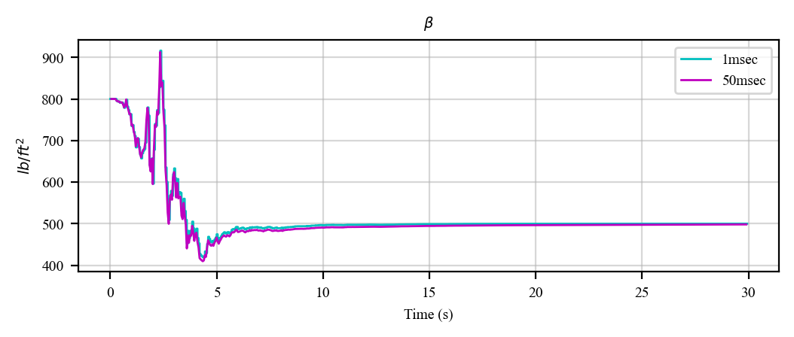
improving as alt descends.
High rate predicts don’t matter.

Slide 19
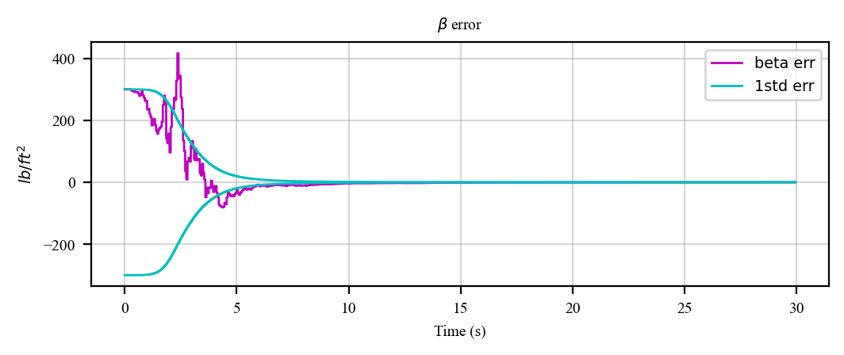
results agree with the covariance matrix.

Slide 20
Results
''' high alt '''
z0 = 200000
vz0 = -6000
betaerr0 = 300
Phis = 0

Slide 21
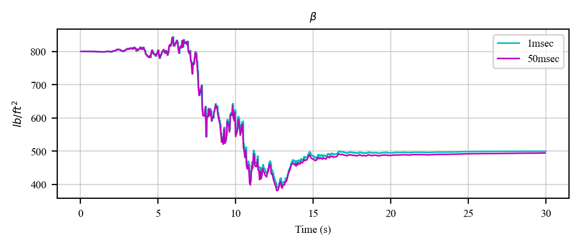
not observable where no drag.
High rate predictions are slightly better

Slide 22
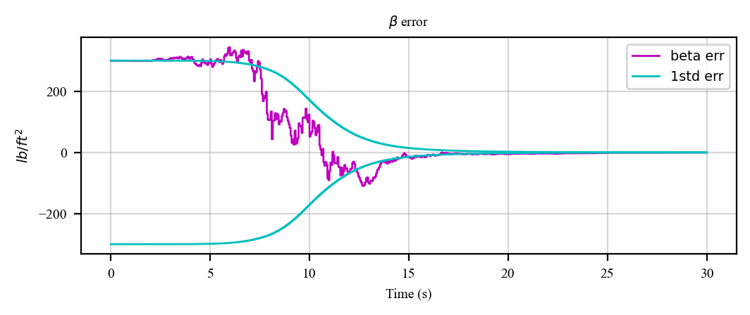

Slide 23
Results
''' high error '''
z0 = 100000
vz0 = -6000
betaerr0 = 1000
Phis = 0

Slide 24
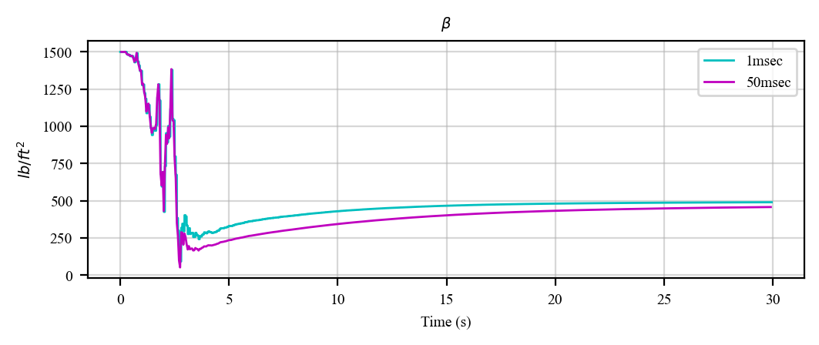
Doesn’t converge.
highly depends on initial conditions!
High rate predicts are helpful to estimate before hitting the ground.
-> if our initial guess is bad high rate predictions help to converge faster the solution

Slide 25
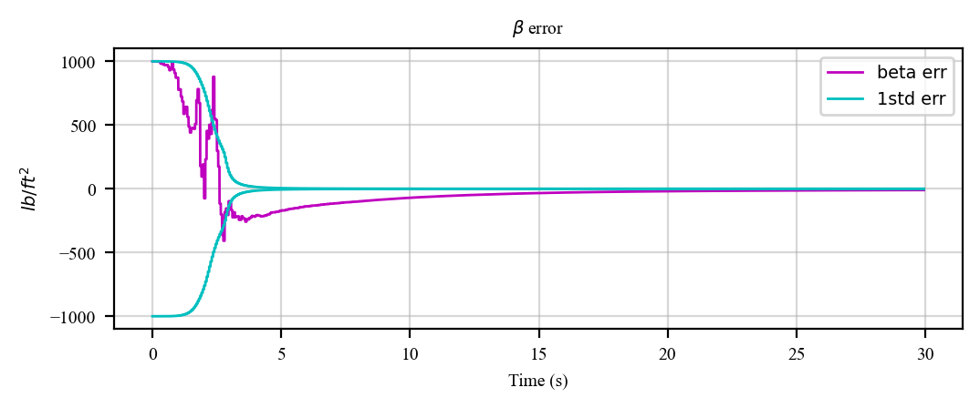
the filter does not even realize when it is broken!

Slide 26
Results
''' process noise '''
z0 = 100000
vz0 = -6000
betaerr0 = 1000
Phis = 1000**2

Slide 27
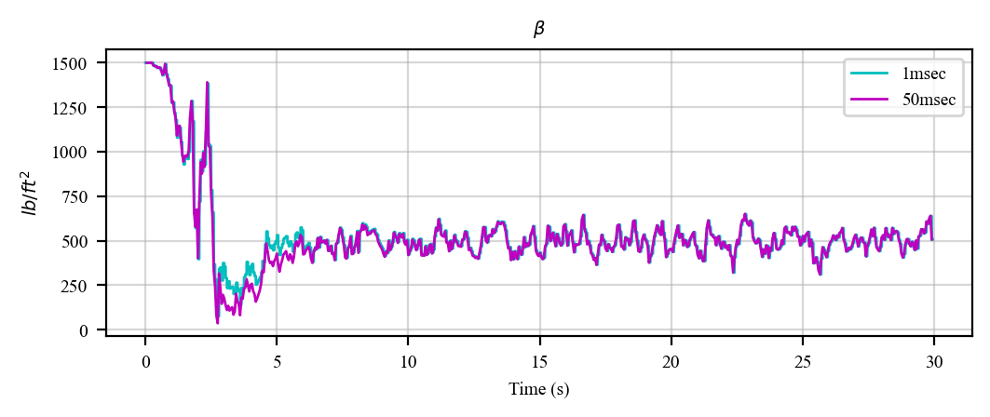
fairly quick convergence.
High rate predicts almost don’t matter
---

Slide 28
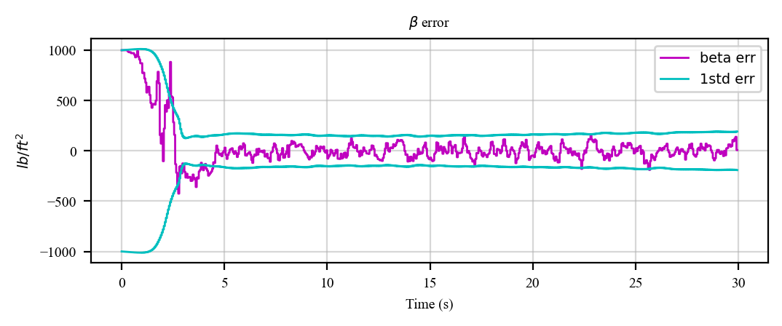
results agree with the covariance matrix

Slide 29
Results
''' nominal + process noise '''
z0 = 100000
vz0 = -6000
betaerr0 = 300
Phis = 300**2

Slide 30
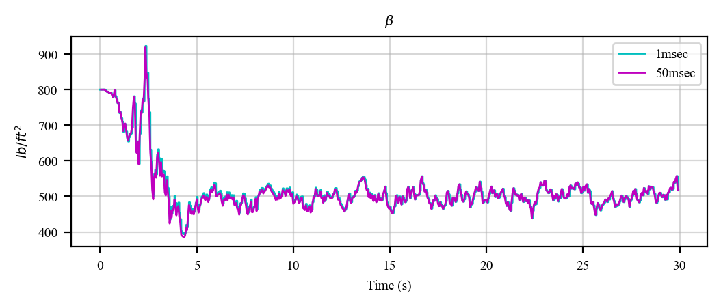
Non accurate steady state error.
The uncertainty reduced from 300 lb/ft2 to about 100 lb/ft2 of error.
more robust to initialization errors filter
no difference between prediction rates

Slide 31
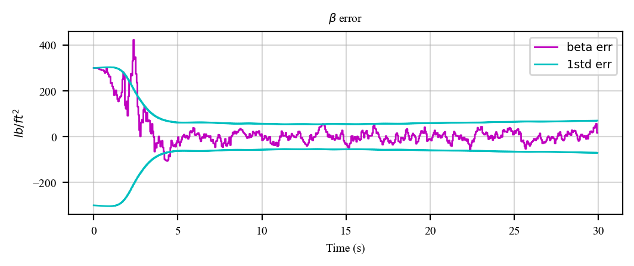

Slide 32
Summary

